Slide 1

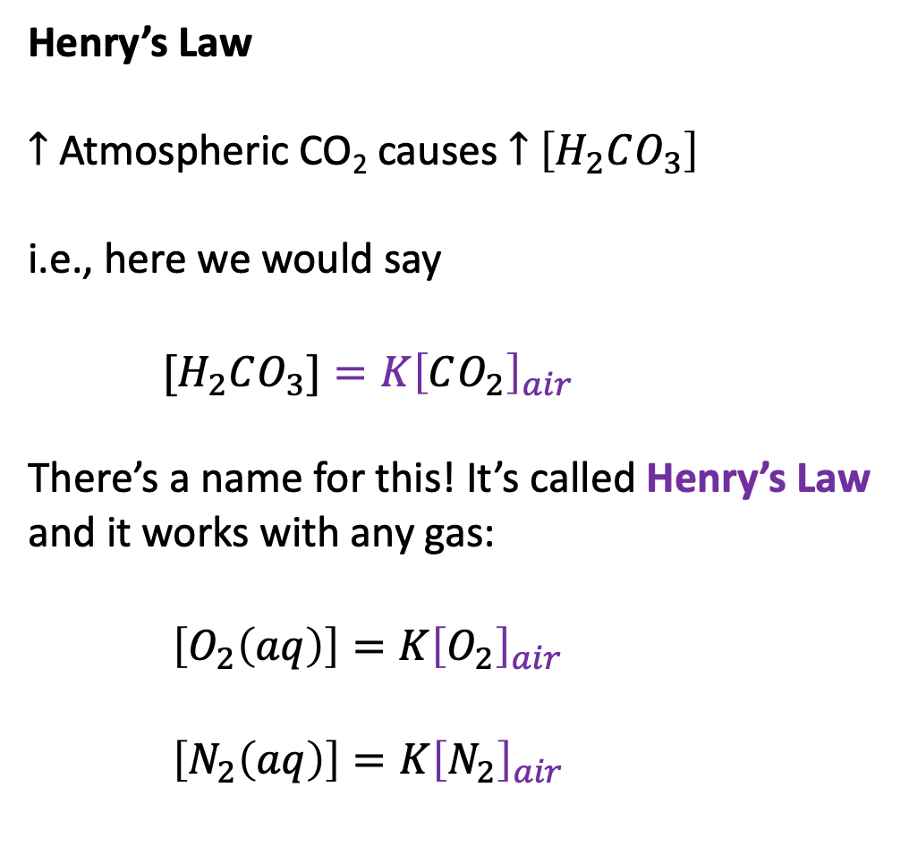


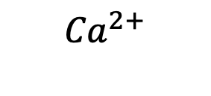




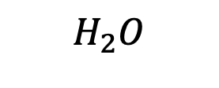
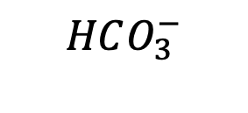

But how does that relate to the atmosphere? First, let’s assert that [H+] is proportional to the concentration of CO2 in the water,
[H+] = K [CO2]_w (2)
Recap: cascade of carbonate reactions
Henry’s Law
$↑$ Atmospheric CO₂ causes $↑$ $\left[H_{2}CO_{3}\right]$
i.e., here we would say
$[H_{2}CO_{3}]=K{\left[CO_{2}\right]}_{air}$
There’s a name for this! It’s called Henry’s Law and it works with any gas:
$\left[O_{2}\left(aq\right)\right]=K{\left[O_{2}\right]}_{air}$
$\left[N_{2}\left(aq\right)\right]=K{\left[N_{2}\right]}_{air}$
Air
$$CO_{2}$$
$$H_{2}O$$
$$H_{2}O$$
Oceans
$H_{2}CO_{3}$
$$H^{+}$$
$$H^{+}$$
$$HCO_{3}^{−}$$
$${Ca}^{2+}$$
$$CO_{3}^{2−}$$
Sea floor
$$CaCO_{3}$$
$$CaCO_{3}^{}$$

Slide 2

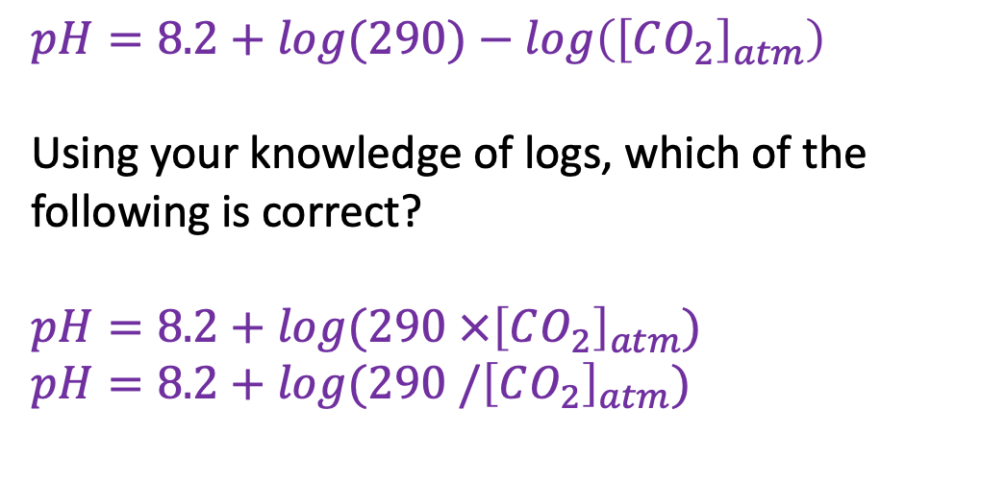
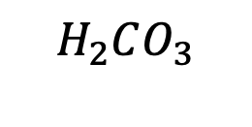





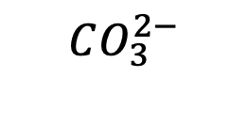

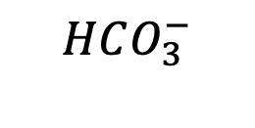

But how does that relate to the atmosphere? First, let’s assert that [H+] is proportional to the concentration of CO2 in the water,
[H+] = K [CO2]_w (2)
A reasonable guess for calculating ocean pH from atmospheric CO2
Air
$$CO_{2}$$
$pH=8.2+log⁡(290)−log\left({\left[CO_{2}\right]}_{atm}\right)$
Using your knowledge of logs, which of the following is correct?
$pH=8.2+log⁡(290 ×{\left[CO_{2}\right]}_{atm})$
$pH=8.2+log⁡(290 /{\left[CO_{2}\right]}_{atm})$
$$H_{2}O$$
$$H_{2}O$$
Oceans
$H_{2}CO_{3}$
$$H^{+}$$
$$H^{+}$$
$$HCO_{3}^{−}$$
$${Ca}^{2+}$$
$$CO_{3}^{2−}$$
Sea floor
$$CaCO_{3}$$
$$CaCO_{3}^{}$$

Slide 3
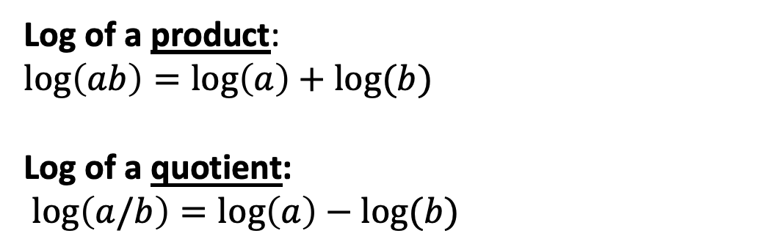
But how does that relate to the atmosphere? First, let’s assert that [H+] is proportional to the concentration of CO2 in the water,
[H+] = K [CO2]_w (2)
A reasonable guess for calculating ocean pH from atmospheric CO2
Air
$$CO_{2}$$
$pH=8.2+log⁡(290)−log\left({\left[CO_{2}\right]}_{atm}\right)$
Using your knowledge of logs, which of the following is correct?
$pH=8.2+log⁡(290 ×{\left[CO_{2}\right]}_{atm})$
$pH=8.2+log⁡(290 /{\left[CO_{2}\right]}_{atm})$
$$H_{2}O$$
$$H_{2}O$$
Oceans
$H_{2}CO_{3}$
$$H^{+}$$
$$H^{+}$$
$$HCO_{3}^{−}$$
$${Ca}^{2+}$$
$$CO_{3}^{2−}$$
Log of a product:
$$\log\left(ab\right)=\log\left(a\right)+log⁡(b)$$
Log of a quotient:
$\log\left(a/b\right)=\log\left(a\right)−log⁡(b)$
Sea floor
$$CaCO_{3}$$
$$CaCO_{3}^{}$$

Slide 4
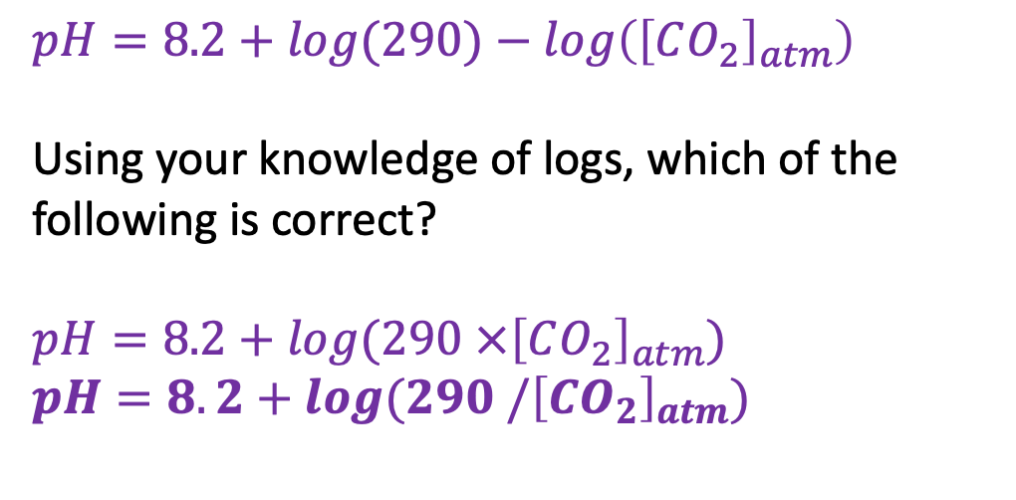
But how does that relate to the atmosphere? First, let’s assert that [H+] is proportional to the concentration of CO2 in the water,
[H+] = K [CO2]_w (2)
Simplifying the ocean pH formula
Air
$$CO_{2}$$
$pH=8.2+log⁡(290)−log\left({\left[CO_{2}\right]}_{atm}\right)$
Using your knowledge of logs, which of the following is correct?
$pH=8.2+log⁡(290 ×{\left[CO_{2}\right]}_{atm})$
$pH=8.2+log⁡(290 /{\left[CO_{2}\right]}_{atm})$
$$H_{2}O$$
$$H_{2}O$$
Oceans
$H_{2}CO_{3}$
$$H^{+}$$
$$H^{+}$$
$$HCO_{3}^{−}$$
$${Ca}^{2+}$$
$$CO_{3}^{2−}$$
Sea floor
$$CaCO_{3}$$
$$CaCO_{3}^{}$$

Slide 5
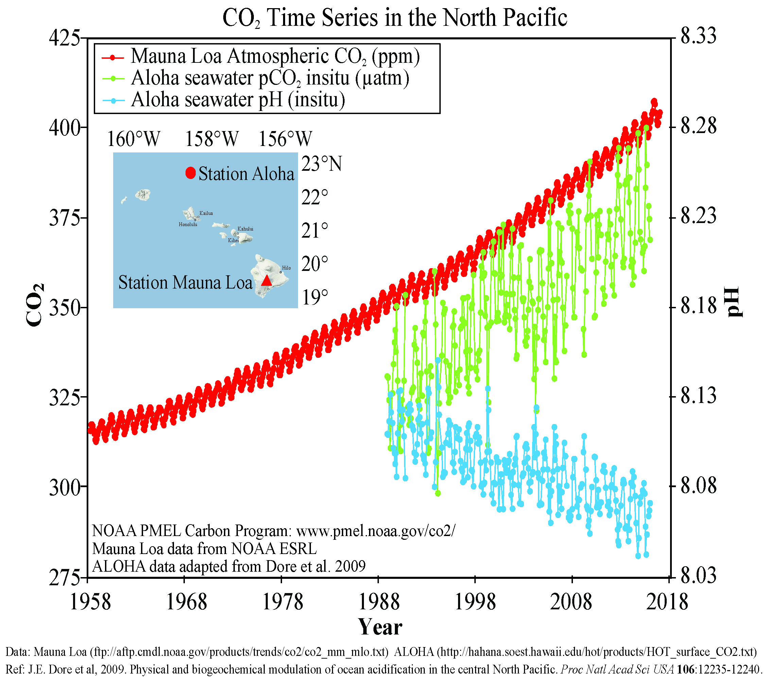
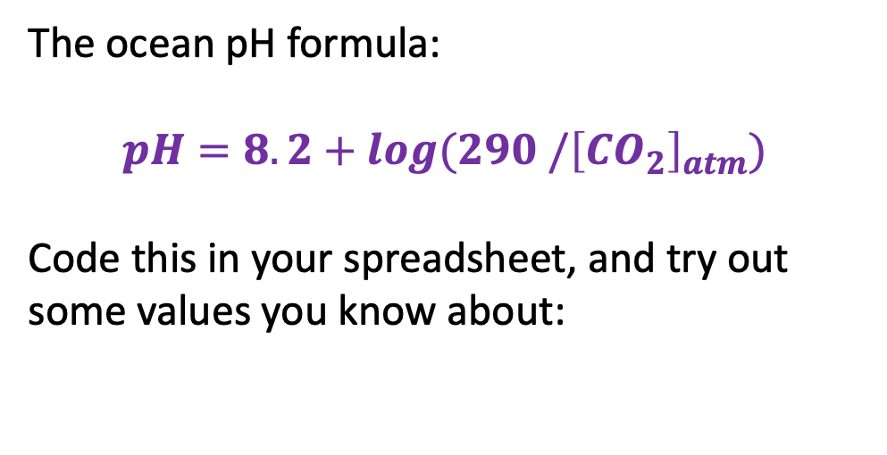
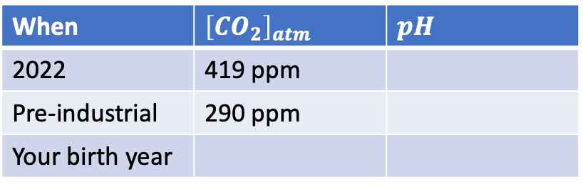
But how does that relate to the atmosphere? First, let’s assert that [H+] is proportional to the concentration of CO2 in the water,
[H+] = K [CO2]_w (2)
Testing the ocean pH formula
The ocean pH formula:
$$pH=8.2+log⁡(290 /{\left[CO_{2}\right]}_{atm})$$
Code this in your spreadsheet, and try out some values you know about:
When | ${\left[CO_{2}\right]}_{atm}$ | $pH$
2022 | 419 ppm
Pre-industrial | 290 ppm
Your birth year

Slide 6
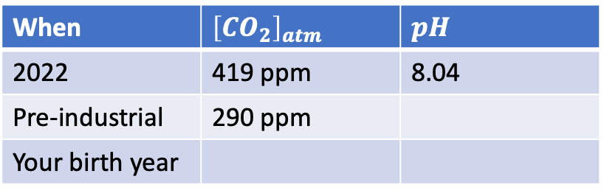
But how does that relate to the atmosphere? First, let’s assert that [H+] is proportional to the concentration of CO2 in the water,
[H+] = K [CO2]_w (2)
Testing the ocean pH formula
The ocean pH formula:
$$pH=8.2+log⁡(290 /{\left[CO_{2}\right]}_{atm})$$
Code this in your spreadsheet, and try out some values you know about:
When | ${\left[CO_{2}\right]}_{atm}$ | $pH$
2022 | 419 ppm | 8.04
Pre-industrial | 290 ppm
Your birth year

Slide 7
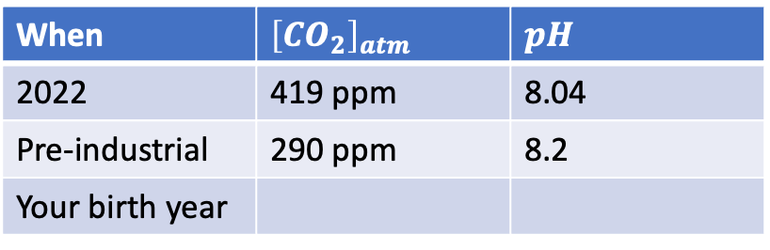
But how does that relate to the atmosphere? First, let’s assert that [H+] is proportional to the concentration of CO2 in the water,
[H+] = K [CO2]_w (2)
Testing the ocean pH formula
The ocean pH formula:
$$pH=8.2+log⁡(290 /{\left[CO_{2}\right]}_{atm})$$
Code this in your spreadsheet, and try out some values you know about:
When | ${\left[CO_{2}\right]}_{atm}$ | $pH$
2022 | 419 ppm | 8.04
Pre-industrial | 290 ppm | 8.2
Your birth year

Slide 8
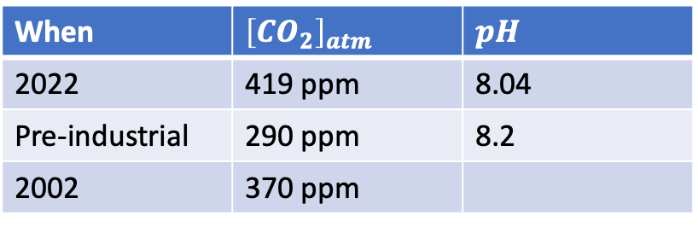
But how does that relate to the atmosphere? First, let’s assert that [H+] is proportional to the concentration of CO2 in the water,
[H+] = K [CO2]_w (2)
Testing the ocean pH formula
The ocean pH formula:
$$pH=8.2+log⁡(290 /{\left[CO_{2}\right]}_{atm})$$
Code this in your spreadsheet, and try out some values you know about:
When | ${\left[CO_{2}\right]}_{atm}$ | $pH$
2022 | 419 ppm | 8.04
Pre-industrial | 290 ppm | 8.2
2002 | 370 ppm

Slide 9
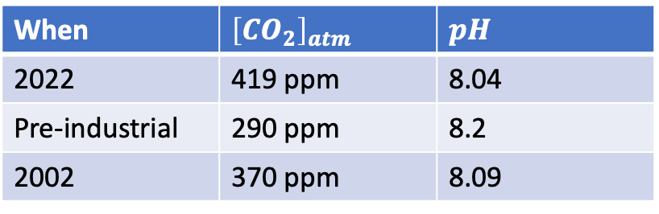
But how does that relate to the atmosphere? First, let’s assert that [H+] is proportional to the concentration of CO2 in the water,
[H+] = K [CO2]_w (2)
Testing the ocean pH formula
The ocean pH formula:
$$pH=8.2+log⁡(290 /{\left[CO_{2}\right]}_{atm})$$
Code this in your spreadsheet, and try out some values you know about:
When | ${\left[CO_{2}\right]}_{atm}$ | $pH$
2022 | 419 ppm | 8.04
Pre-industrial | 290 ppm | 8.2
2002 | 370 ppm | 8.09

Slide 10
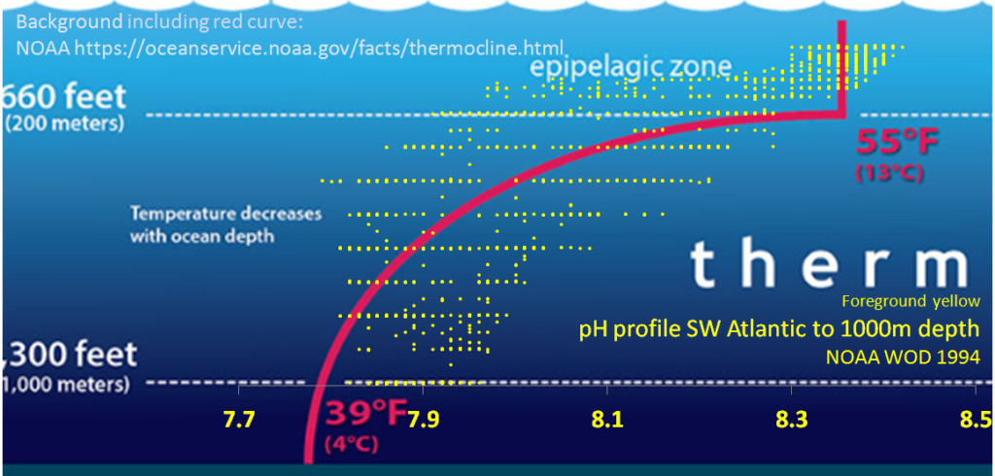
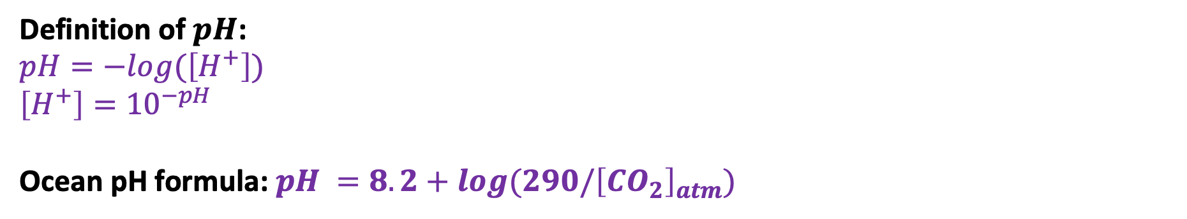
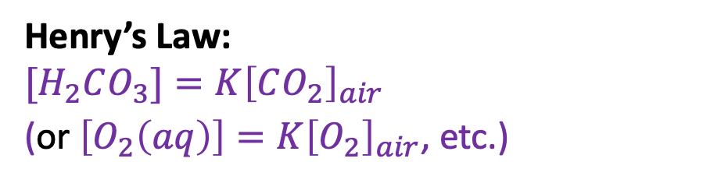
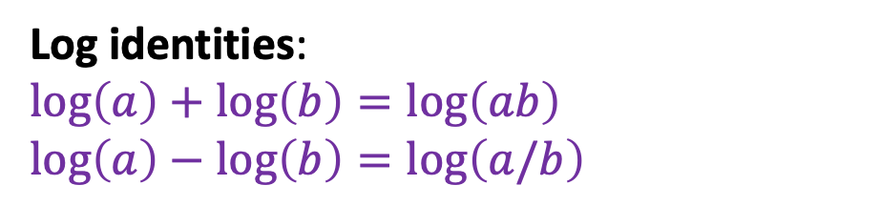
But how does that relate to the atmosphere? First, let’s assert that [H+] is proportional to the concentration of CO2 in the water,
[H+] = K [CO2]_w (2)
Take-home points
Definition of $pH$:
$pH=−log⁡(\left[H^{+}\right])$
$$\left[H^{+}\right]={10}^{−pH}$$
Ocean pH formula: $pH =8.2+log⁡(290/{\left[CO_{2}\right]}_{atm})$
Log identities:
$\log\left(a\right)+\log\left(b\right)=\log\left(ab\right)$
$$\log\left(a\right)−\log\left(b\right)=\log\left(a/b\right)$$
Henry’s Law:
$$[H_{2}CO_{3}]=K{\left[CO_{2}\right]}_{air}$$
(or $\left[O_{2}\left(aq\right)\right]=K{\left[O_{2}\right]}_{air}$, etc.)
Applies to the surface (top 200 meters) of the ocean

Slide 11
Now about preparing those reviews …

